Slide 1
welcome to
COMP 2691
Intermediate Windows Application Development in .NET
Week 8
Windows Services
Amir Ahani, M.Sc. + MBA
Microsoft Certified Solution Developer (MCSD .NET)
Microsoft Certified Database Administrator (MCDBA)
Email: amirahani@gmail.com
<number> of 33
Notes:
COMP2690 Windows Application Development with C#

Slide 2
Today…
  What is a Windows Service?
  How to Create a Service Project?
  How to Implement a Service?
  How to Create an Install Project for a Service?
  How to Manage and Control a Service?
  Lab: Create, Install, and Start a Service to Monitor a site
<number> of 33
Notes:
COMP2690 Windows Application Development with C#

Slide 3
Services
Creating Windows Services
  Creating services enables you to run an assembly in the background,
  without any interaction from the user. Services are perfect when you
  want to continuously monitor something, when your assembly needs
  to listen for incoming network connections, or when you need to
  launch your assembly before the user logs on.
  Because of their unique nature, services require special security and
  installation considerations.
<number> of 33

Slide 4
Services
What is a Windows Service?
  Windows services are processes that run in the background, without
  a user interface, and in their own user session. Services can be
  automatically started when the computer starts, even if a user does
  not log on. Therefore, services are an ideal way to implement an
  application that should be running constantly and does not need to
  interact with the user. Windows has dozens of services built-in,
  including Server (which shares folders on the network), Workstation
  (which connects to shared folders), and World Wide Web Publishing
  (which serves Web pages).
<number> of 33

Slide 5
Understanding Windows Services
The Windows operating system provides the following services:
  Kernel Services – The kernel is the core part of the operating
  system responsible for process, thread, and memory management.
  Kernel services enable devices and applications to interact with the
  kernel and use its functionality (System Programmers)
  Device Driver Services – A device driver controls and manages the
  hardware devices. Device driver services enable applications to work
  with devices (System Programmers)
  Windows Services – Windows services enable operating system
  components and application programs to expose their functionality to
  other applications.
<number> of 33

Slide 6
Understanding Windows Services
In general, a Windows service is a process that provides background
services to other processes. Some typical examples of Windows
services are World Wide Web Publishing, Print Spooler, Task Scheduler,
Event Log, Plug and Play, and so on. Some common characteristics of
Windows services are:
  Conformance to SCM—Each Windows service must implement a set of
  well-known methods, which enable the service to communicate with the
  SCM. These well-known methods define how a Windows service should
  handle the SCM messages. Some common messages sent by SCM to a
  service are Start, Pause, Continue, and Stop. How these messages are
  handled depends totally on the service, because not all Windows services
  accept all messages. For example, the Event Log, the Plug and Play, and the
  Security Accounts Manager Windows services do not accept Pause and Stop
  messages and therefore cannot be paused or stopped. In contrast, the Print
  Spooler and the System Event Notification Windows services can be started
  or stopped but cannot be paused.
<number> of 33

Slide 7
Understanding Windows Services
  Lack of User Interface—Although Windows services can interact with the
  desktop and provide a user interface, most services don’t. Windows services
  perform system tasks that usually do not require any user interface. As an
  example, the job of IIS (Internet Information Services) is to serve the
  requested Web pages, and IIS does not require any user interface or desktop
  interaction to accomplish this job. IIS is launched when a computer is started
  and its process remains unseen by a Windows desktop user.
  Specific User Identity—Most Windows services run with System privileges.
  System is a special account that Windows uses to perform privileged
  operations. However, each Windows service can be launched with a specific
  user identity. This feature can restrict services to the permissions defined for
  an individual user. The administrator can easily accomplish this by following these two steps:
    1. Set up a user account with the set of permissions that the administrator wants the service to have.
    2. Configure the Windows service to run with the user identity that was created in step 1.
<number> of 33

Slide 8
Understanding Windows Services
  Separate Windows Process—A Windows service does not run in the
  process of the program that communicates with it. Instead, a Windows
  service runs in its own process. Sometimes, a Windows service can also
  share a process with another Windows service.
  Special Installation Procedure—Unlike a Windows application, a Windows
  service cannot be started by just executing its .exe file. Instead, a Windows
  service requires a special installation procedure. This installation procedure
  registers the Windows service with the Windows Service Control Manager
  (SCM). The SCM provides varied functionality to control (such as to start,
  pause, and stop a service) and configure (such as setting up a service user
  account) the Windows services.
  Long-lived Process—Typically, a Windows service is started automatically
  when the computer is started and continues to live. Services can execute
  even when no user is logged on to the system. Most Windows services
  provide the functionality that enables them to be paused, resumed, started,
  or stopped.
<number> of 33

Slide 9
Practical Point
→ Communication via Event Log
Windows services run in the background and generally do not provide a
user interface. However, a Windows service may need to inform the user
about an application state or an event in the environment. Most Windows
services do so by writing informative messages in the event log.

Slide 10
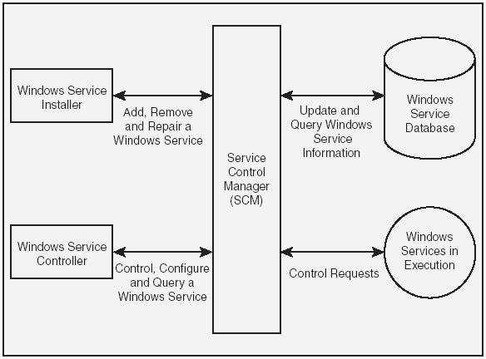
Architecture of Windows Services
<number> of 33

Slide 11
Architecture of Windows Services
Windows Service Database
  The Windows service database stores information about all the installed
  services. This database is a part of the Windows Registry and is stored in the
  HKEY_LOCAL_MACHINE\SYSTEM\CurrentControlSet\Services key. The
  Windows service database typically contains the following information for
  each Windows service:
    Path to the executable file.
    Security settings.
    Startup parameters.
  Even though you can directly manipulate the Windows service database by
  modifying the Windows Registry using the regedit command or through a
  program, it is not recommended that you do so. To ensure the integrity of the
  database, you should always manipulate the Windows service database
  through the interfaces that the SCM provides.
  Example: MSSQLServer Auto-start service (Auto-Start → 2, Manual → 3)
<number> of 33

Slide 12
Architecture of Windows Services
Service Control Manager (SCM)
  SCM is a Windows component that maintains the Windows service
  database and provides a unified way to control, configure, and
  access these services. The SCM performs the following tasks:
    Accepts requests to install and uninstall Windows services from
    the Windows service database.
    Starts Windows services either on system startup or on demand.
    Transmits control messages (such as Start, Stop, Pause, and Continue)
    to running Windows services.
    Locks and unlocks the Windows service database.
  Windows provides a generic interface to work with the SCM through the
  Services and Computer Management MMC (Microsoft Management
  Console) snap-ins. These MMC snap-ins can be accessed through the
  Administrative tool section of the Windows Control Panel. Some applications,
  such as IIS and SQL Server, provide their own MMC snap- ins to control and
  configure their services.
<number> of 33

Slide 13
Architecture of Windows Services
Windows Service Installer
  A Windows service installer uses the SCM to install, uninstall, and repair a
  Windows service. The install, uninstall, and repair actions respectively
  create, delete, and update a Windows service record in the Windows service
  database.
  While installing a service, the Windows service installer also stores
  information about how the service will be started. This information includes:
    A name that uniquely identifies the service in the Windows service
    database.
    The account name and password under whose identity the service runs.
    How the Windows service process is created (an independent process or
    a shared process).
    How the service is started (automatically when Windows starts, manual
    start, disabled).
<number> of 33

Slide 14
Architecture of Windows Services
Windows Services in Execution
  A Windows service must be explicitly started (by default). However, it is also
  possible to set up a service in such a way that the service is started
  automatically with Windows.
  When the SCM starts a service, it attempts to create a Windows process for
  that service based on the information stored in the Windows service
  database. The SCM also sends a Start message to the service; this message
  invokes an associated handler in the service (if any) that specifies the
  processing to be done. After a Windows service is started, it continues to run
  until it receives a pause message or a stop message.
  When a Windows service is paused, the process for the Windows service
  continues to exist, but the service does not listen to the requests from the
  client programs. On the other hand, when a Windows service is stopped, its
  process is terminated and the memory is reclaimed.
<number> of 33

Slide 15
Architecture of Windows Services
Windows Service Controller Program
  The Windows service controller program uses the SCM to perform the
  following tasks:
    Start a Windows service.
    Stop a Windows service.
    Pause a Windows service.
    Resume the execution of a paused Windows service.
    Query the Windows service database to retrieve the status for a Windows service.
    Install a new Windows service in the Windows service database.
    Uninstall an installed Windows service from the Windows service
    database.
    Modify the configuration information for a Windows service.
  Although the Services MMC snap-in provides generic control and
  configuration options for Windows services, it cannot take care of the
  individual configuration requirements and customized user interface for each
  Windows service.
<number> of 33

Slide 16
The FCL Support for Windows Services
The System.ServiceProcess namespace provides the classes that
enable you to implement, install, and control Windows services. The
main classes involved in working with Windows service applications are:
  The ServiceBase Class A class that provides the base-level functionality
  for a Windows services application.
  The ServiceProcessInstaller and ServiceInstaller Classes
  Classes that enable you to use an installation utility such as installutil.exe to
  install a Windows services application.
  The ServiceController Class A class that enables a program to connect to
  a Windows service and perform various operations such as starting,
  stopping, querying etc.
<number> of 33

Slide 17
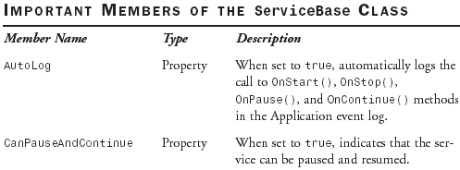
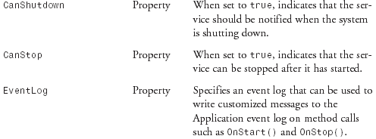
Creating a Windows Service Application
The System.ServiceProcess.ServiceBase Class

Slide 18
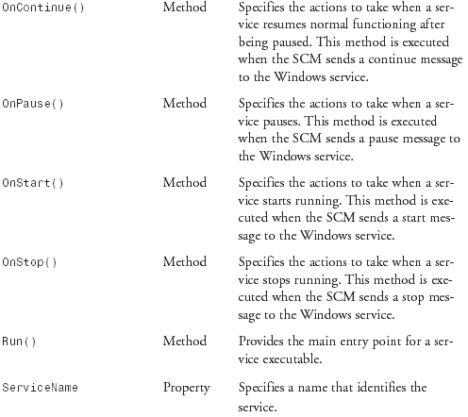
Creating a Windows Service Application
The System.ServiceProcess.ServiceBase Class

Slide 19
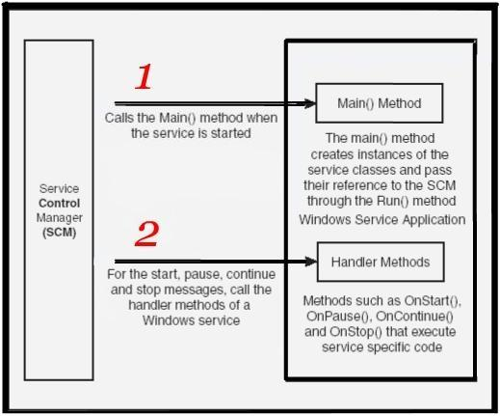
How the SCM Interacts with a Service
A Windows service application contains one or more classes that inherit
from the ServiceBase class to define a Windows service.
Only one of these classes can define a Main() method, which is the main
entry point for the application. The Main() method specifies which
Windows services should run by passing the instances of the Windows
service to the static ServiceBase.Run() method.
The Run() method does not actually start the Windows service; instead,
the Run() method just passes references to the Windows service objects
to the SCM. The SCM uses these objects to send messages to the
Windows service.
<number> of 33

Slide 20
Services
How to Create a Service Project?
  1. Create a project using the Windows Service application template. This
  template creates a class for you that inherits from ServiceBase and
  writes much of the basic service code, such as the code to start the service.
  2. Write the code for the OnStart and OnStop procedures, and override any
  other methods that you want to redefine.
  3. Add the necessary installers for your service application. By default, a
  class containing two or more installers is added to your application when you
  click the Add Installer link: one to install the process, and one for each of the
  associated services your project contains.
  4. Build your project.
  5. Create a setup project to install your service, and then install it.
  6. Use the Services snap-in to start your service.
<number> of 33

Slide 21
Services
How to Implement a Service?
  In the properties for your designer, modify the ServiceBase.ServiceName
  property. Every service must have a unique name; therefore, it is very
  important to change this setting. ServiceName is not the friendly name you
  will see in the Services snap-in. Instead, ServiceName is used by the
  operating system to identify the service and can be used to programmatically
  identify the service. For example, you can start a service from the command
  line by running Net Start ServiceName.
  Optionally, override the OnPause, OnContinue, and OnShutdown methods.
  OnPause is called when a user pauses your service from the Services snap-
  in (a rare event). OnContinue is called when a service resumes from a
  paused state. Finally, OnShutdown is called when a computer shuts down.
  If you do override these methods, set ServiceBase.CanPauseAndContinue
  or ServiceBase.CanShutdown to true.
<number> of 33

Slide 22
Services
How to Create an Install Project for a Service?
  Unlike with other applications, you cannot simply run a service executable
  file. This limitation prevents you from running and debugging the application
  directly from the Visual Studio development environment. Services must be
  installed prior to running.
  The .NET Framework provides the ServiceInstaller and
  ServiceProcessInstaller classes for this purpose. Use ServiceInstaller to
  define the service description, display name, service name, and start type.
  Use ServiceProcessInstaller to define the service account settings.
  In practice, you will not need to write code that uses the ServiceInstaller and
  Service-ProcessInstaller classes because Visual Studio will automatically
  generate the code.
<number> of 33

Slide 23
Services
How to Specify the Security context of the Service?
  Set the Account property for the ProjectInstaller ServiceProcessInstaller
  component to one of the following values:
  LocalService Runs in the context of an account that acts as a nonprivileged
  user on the local computer, and presents anonymous credentials to any
  remote server. Use LocalService to minimize security risks.
  NetworkService Enables the service to authenticate to another computer
  on the network. This authentication is not required for anonymous
  connections, such as most connections to a Web server.
  LocalSystem The service runs with almost unlimited privileges and presents
  the computer’s credentials to any remote server. Using this account
  type presents a severe security risk; any vulnerabilities in your application
  could be exploited to take complete control of the user’s computer.
  User (the default) Causes the system to prompt for a valid user name and
  password when the service is installed (unless you set values for both the
  Username and Password properties of your ServiceProcessInstaller ).
<number> of 33

Slide 24
Services
How to Install a Service Manually?
  After you implement and build your service, you can install it manually. To
  install a service manually, run InstallUtil.exe from the command line with your
  service’s name as a parameter.
  To install your service, run InstallUtil yourservice.exe.
  To uninstall your service, run InstallUtil /u yourservice.exe.
<number> of 33

Slide 25
How the SCM Interacts with a Windows Service
When the SCM sends a start message to the Windows service, the
following things happen:
  1. The SCM finds the path of the Windows service application’s executable
  file from the Windows service database.
  2. The SCM creates a Windows service process by executing the Main()
  method defined in the Windows service executable.
  3. The Main() method of the Windows service executable creates one or
  more instances of the Windows service class and passes their references
  to the SCM through the static Run() method of the ServiceBase class. The
  SCM uses these references to send messages to the Windows service.
  4. The handler associated with the start message—the OnStart() method—is
  executed. The OnStart() method executes the code that is required for a
  Windows service to run, such as listening to a port for incoming requests,
  logging events to the event log, spooling print jobs, and so on.
  After the Windows service is started, the SCM can use its reference to send
  various messages such as pause, continue, and stop to the Windows
  service.
<number> of 33

Slide 26
Creating the OrderService Application
// Executes when an XML file is created in or copied to the c:\orders directory
private void fswOrders_Created(object sender, System.IO.FileSystemEventArgs e){
DataSet dsOrders = new DataSet(“Orders”);
// Read the contents of the XML file into the Orders DataSet
dsOrders.ReadXml(e.FullPath);
// set up the database connection string
string strConn = “data source=(local);” + “initial catalog=Northwind;” + “integrated security=SSPI”;
string strOrderQuery = “SELECT * FROM Orders”;
// Create a DataAdapter for the Orders table of the Northwind database
SqlDataAdapter daOrders =new SqlDataAdapter(strOrderQuery, strConn);
// Automatically generate the update command to reconcile the changes made to the DataSet
SqlCommandBuilder cbOrders =new SqlCommandBuilder(daOrders);
//Update the DataSet
daOrders.Update(dsOrders, “Orders”);
daOrders.Dispose();
FileInfo fi = new FileInfo(e.FullPath);
// Create a subdirectory named “Updated” if it does not already exist
fi.Directory.CreateSubdirectory(“Updated”);
// Copy the processed XML file to updated directory, overwriting if needed
File.Copy(e.FullPath, fi.DirectoryName + @”\Updated\” + fi.Name, true);
// Delete the XML file from its original location
fi.Delete();
}
To demonstrate how Windows services are created, We will create an
OrderService that listens for XML files containing order information in a particular
disk directory (c:\orders). As soon as XML file is created in directory, the service
reads the files and based on its data, creates a new record in the orders table of
the Northwind database. This type of application is typically used for updating
orders received from the internet, from business partners, and from the legacy
aaplications.
<number> of 17

Slide 27
Practical Point
→ The FileSystemWatcher Component may lose track of changes
The FileSystemWatcher component stores the file system changes in a
property named InternalBufferSize before it acts upon those changes.
If there are too many changes in a short time, this buffer can overflow
and cause the FileSystemWatcher component to lose track of the file
system changes. This buffer’s default size is 8192 bytes. You should
not arbitrarily increase this buffer’s size because this buffer is
maintained in non-paged memory and increasing its size would directly
impact the performance of other applications. Instead, you should use
the Path, NotifyFilter, and IncludeSubdirectories properties to narrow
down the scope of notifications that the FileSystemWatcher component
receives.

Slide 28
Services
How to Build a Setup Project for a Service?
  Add a Setup Project to your current solution.
  Add the output from your service project to your setup project by following these steps:
  A. Right-click your setup project in Solution Explorer, click Add, and then
  click Project Output.
  B. In the Add Project Output Group dialog box, select your service project
  from the Project list, select Primary Output, and then click OK.
  Finally, add a custom action to install the service executable file by following
  these steps:
  A. Right-click your setup project in Solution Explorer, click View, and then
  click Custom Actions.
  B. In the Custom Actions editor, right-click Custom Actions and then click
  Add Custom Action.
  C. In the Select Item In Project dialog box, select the Application Folder, and
  then select Primary Output From your service project name, Click OK. The
  primary output is added to all four nodes of the custom actions: Install,
  Commit, Rollback, and Uninstall.
  D. In Solution Explorer, right-click your setup project and then click Build.
  The service setup build folder now includes a Setup.exe file to interactively
  install the service and an MSI file for automatic deployment of the service.
<number> of 33

Slide 29
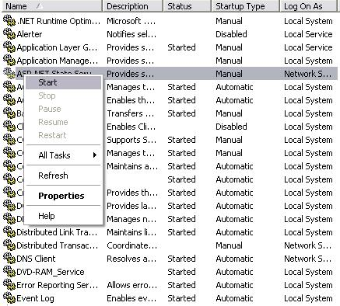
Services
How to Manage and Control a Service?

Slide 30
Services
How to Manage and Control a Service?
  You can control services from the command line by using the Net
  command with the following formats:
  Net Start ServiceName
  or
  Net Stop ServiceName.
<number> of 33

Slide 31
Using Tools to Monitor a Windows Service
Using the Services MMC Snap-in
Using Visual Studio .NET Server Explorer
Using the NET Utility (net.exe)
  Net Start (Pause, Continue and Stop)
Using the Service Control Utility (sc.exe)
  The Service Control utility provides various options to start, pause, continue, stop, configure, and query a Windows service
<number> of 33

Slide 32
Lab: Create, Install, and Start a Service to Monitor a Web Site
private Timer t = null; // System.Timers - System.Net - System.IO
public MonitorWebSite()
{
InitializeComponent();
t = new Timer(10000);
t.Elapsed += new ElapsedEventHandler(t_Elapsed);
}
void t_Elapsed(object sender, ElapsedEventArgs e)
{
try
{
// Send the HTTP request
string url = "http://www.microsoft.com";
HttpWebRequest g = (HttpWebRequest)WebRequest.Create(url);
HttpWebResponse r = (HttpWebResponse)g.GetResponse();
// Log the response to a text file
string path = AppDomain.CurrentDomain.SetupInformation.ApplicationBase + "log.txt";
TextWriter tw = new StreamWriter(path, true);
tw.WriteLine(DateTime.Now.ToString() + " for " + url + ": " + r.StatusCode.ToString());
tw.Close();
// Close the HTTP response
r.Close();
}
catch (Exception ex)
{
System.Diagnostics.EventLog.WriteEntry("Application", "Exception: " + ex.Message.ToString());
}
}
protected override void OnStart(string[] args)
{
t.Start();
}
protected override void OnStop()
{
t.Stop();
}
protected override void OnContinue()
{
t.Start();
}
protected override void OnPause()
{
t.Stop();
}
protected override void OnShutdown()
{
t.Stop();
}
In this lab, you create a service project using Visual Studio, and write code to log the status of a Web page every 10 seconds.
<number> of 33

Slide 33
Summary
  A Windows service is a process that runs in the background,
  without a user interface, in its own user session.
  To create a Windows service, use Visual Studio to create a project
  using the Windows Service application template. Then write the
  code for the OnStart and OnStop procedures, and override any
  other methods that you want to redefine. Add the necessary
  installers for your service application. Finally, create a setup
  project to install your service.
  To implement a service, specify the service name, description, and
  startup type. Then override the OnStart, OnStop, OnPause,
  OnContinue, and OnShutdown procedures as necessary.

